Slide 1
2020 BGC FO Learning Review– Apr.28.2020
LIU Lin, XU Ziyuan, ZHANG Shishi, ZHANG Jialong
Mentor: QIU Yue(Grace)

Slide 2
Agenda
Topics | Presenter | Time
Learning C# Programming | Jialong ZHANG | 5 min
Individual Projects | Ziyuan XU | 5 min
Windows Forms Applications | Lin LIU | 5 min
Quality Management | Shishi ZHANG | 5 min
Q&A | All | 10 min

Slide 3
C# Programming
Jialong ZHANG

Slide 4

Daily Schedule
Daily Stand-up Meeting 9:00 – 9:30
WeChat Voice Call; Context and Knowledge Sharing by Grace; Status Sharing; Plan Making;
Daily Review 18:00
Status Sharing in WeChat; Code Review; Interactive Real-Time Learning; Help Session;
Free Discussion Chatroom all-day

Slide 5


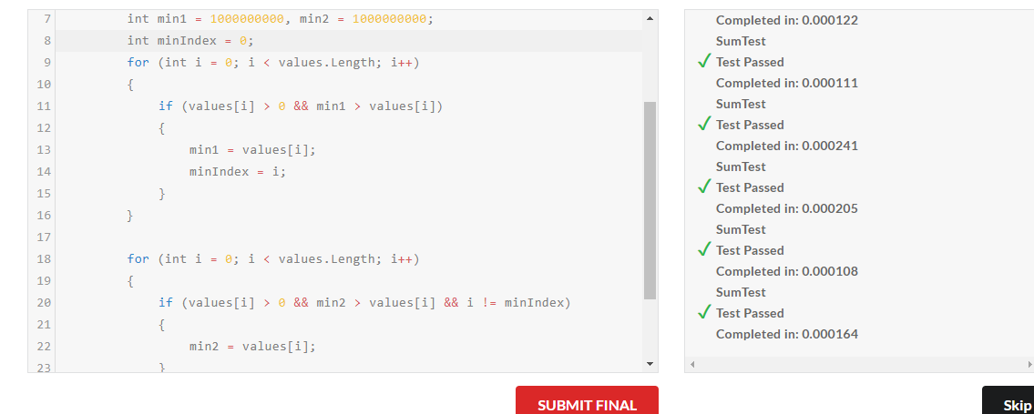
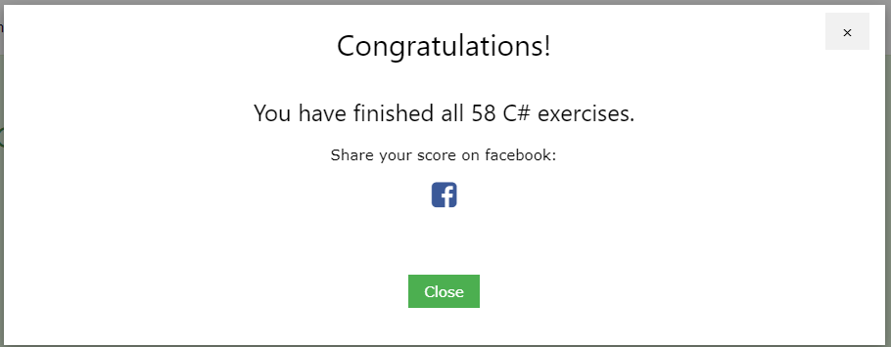
Learning the C# Language
Text book: Illustrated C# 7 (C#图解教程）
https://github.com/Archangelxzy/Csharp--/blob/master/ReadNote.md by LIU Lin
Programming Practices: Edabit, Leetcode, etc.
https://github.com/jzhang182
Further learning materials: Microsoft documents, Pluralsight, etc.

Slide 6
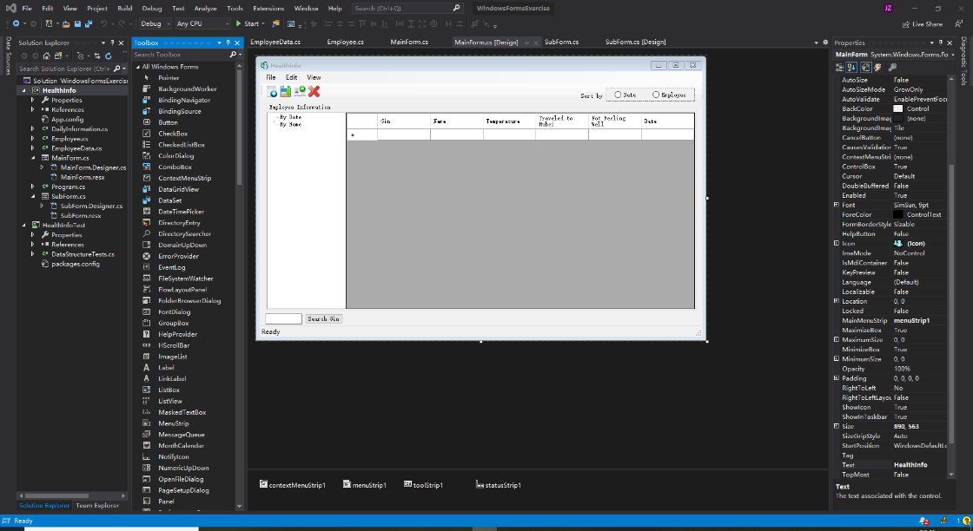
Softwares and extensions usage
Coding: Visual Studio Code, Visual Studio 2019 Community
Quality Management: OpenCover, Xmind,

Slide 7
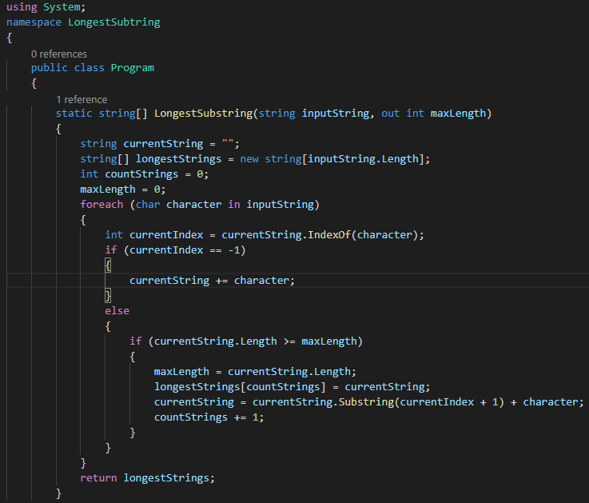
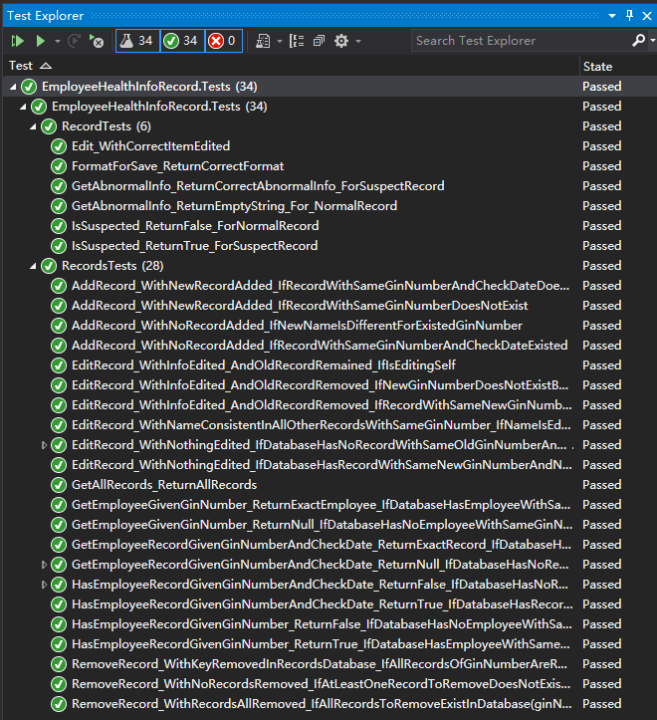
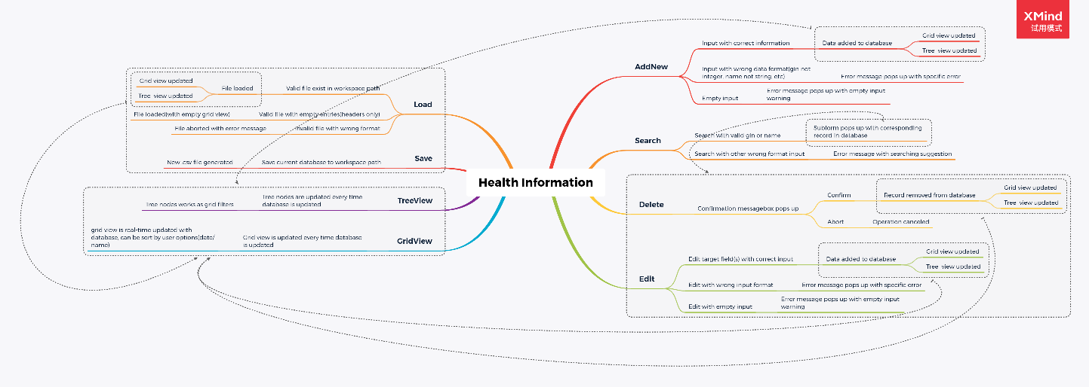
Individual Projects and Testing
Coding exercises and challenges
Algorithms: Searching, Sorting, etc.
Performance: Speed, Stability
User Friendly: Naming and coding rules, code review
Console Apps
Trajectory Views
Health Records System
Unit testing and UX
Windows Forms Apps
Health Records System
Test Cases
MindLine

Slide 8
Windows Forms Applications – case: Employee Health Records System
Lin LIU

Slide 9
Objective
Learn building graphically rich interactive applications
Learn Windows Forms programming
Windows Forms controls
Handling of user inputs, event handlers
UI & UX design
Learn quality management
Notes:
That meets the needs of users, and which is easy to use even for non-technical users
One way is using windows forms ,...
Compare to console application, GUI application means more codes to implement and maintain, and also more possibilities to have bugs or errors during the development, quality management is the way to assure the usability of application in such complex situations.(?)

Slide 10
Employee Health Records System - Requirements
Basic operations: Add, Edit, Delete, Load, Save
Filters: Date, Name, GinNumber, Suspects
User Experience
Shortcuts support
Error messages
Full-featured, but also easy to use

Slide 11
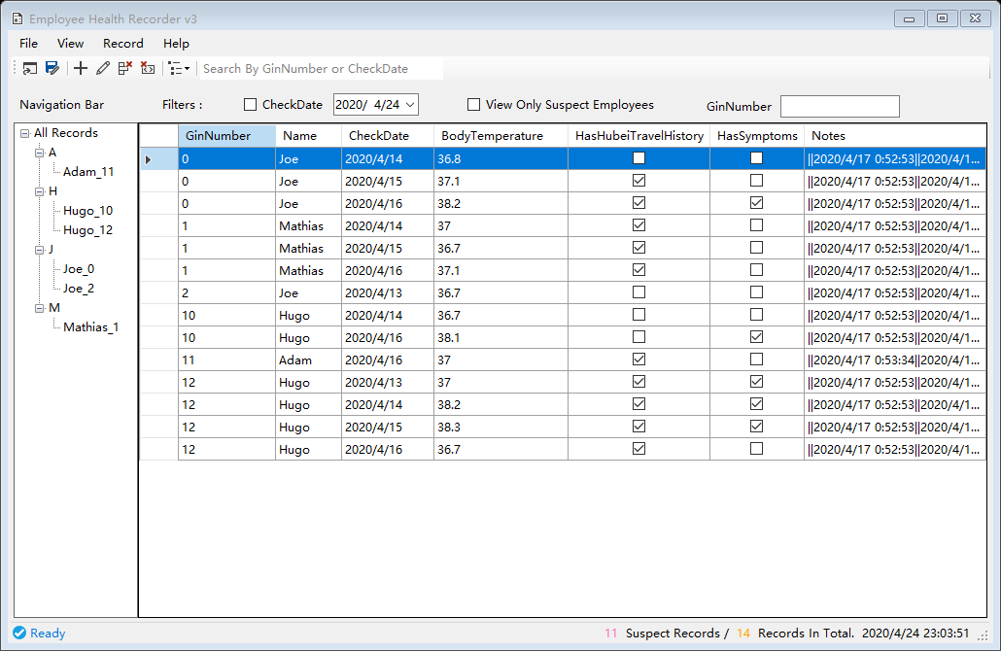
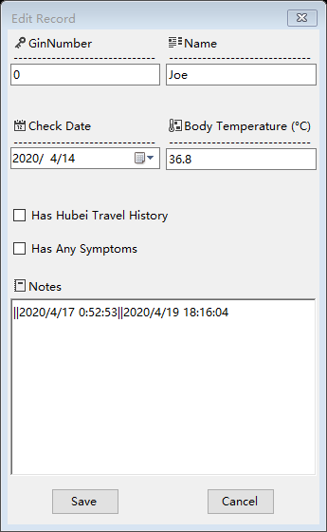
Employee Health Records System - Solution
Records Explorer
Record Editor

Slide 12
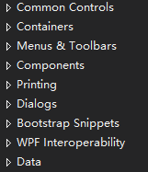
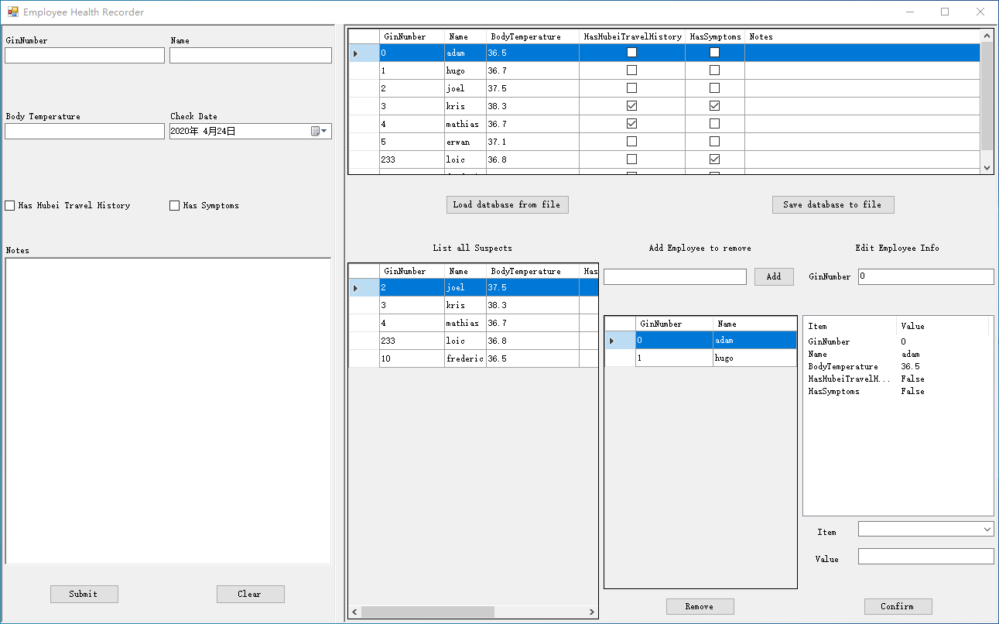
Conclusion
Take one month from beginning to a deliverable application
What we have learned
Windows Forms programming
Good UI & UX design
Continuous Development & Continuous Testing
List of controls
Solution v0

